Slide 1
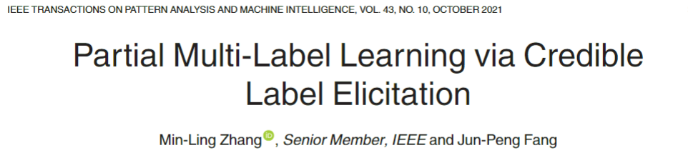
汇报人：项桂巳雨
2023/03/18

Slide 2
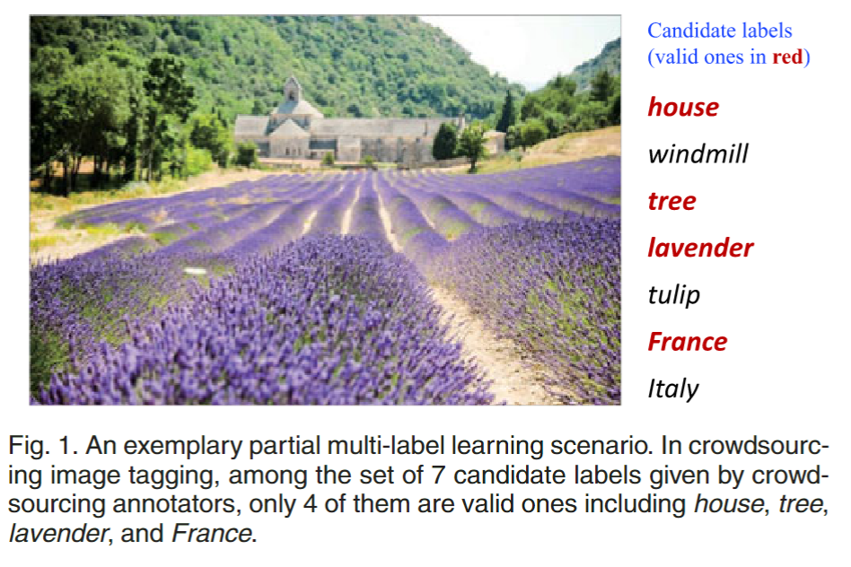
Partial Multi-Label Learning via Credible Label Elicitation
Partial Multi-Label Learning

Slide 3
Partial Multi-Label Learning via Credible Label Elicitation
Partial Multi-Label Learning
Basic Strategy:
treat all candidate labels as groundtruth ones.
choose to disambiguate candidate label set by estimating the confidence of each candidate label being the ground-truth one.

Slide 4
Partial Multi-Label Learning via Credible Label Elicitation
PARTICLE
(PARTIal multi-label learning via Credible Label Elicitation)
1. Credible Label Elicitation
2. Predictive Model Induction
2.1. Virtual Label Splitting
2.2. MAP Reasoning

Slide 5

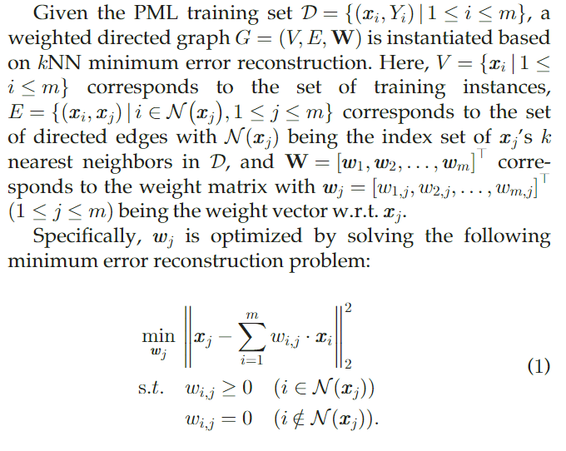
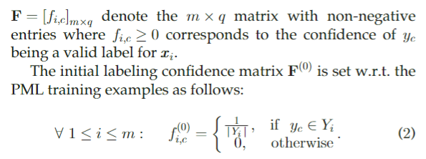

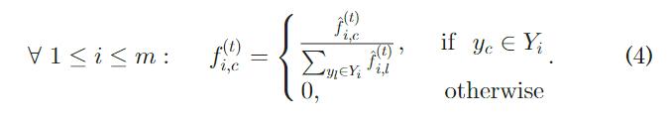
Partial Multi-Label Learning via Credible Label Elicitation
1. Credible Label Elicitation

Slide 6
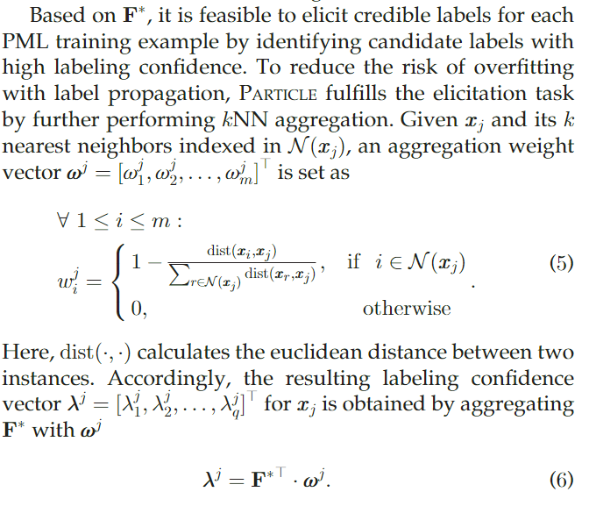
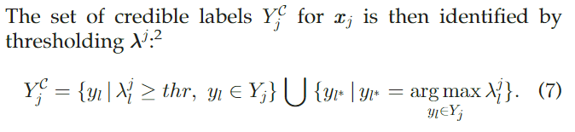
Partial Multi-Label Learning via Credible Label Elicitation
1. Credible Label Elicitation

Slide 7
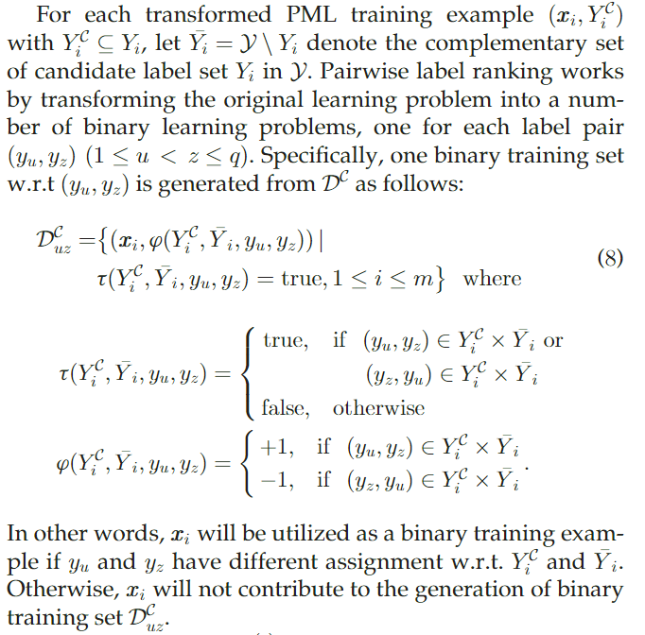
Partial Multi-Label Learning via Credible Label Elicitation
2. Predictive Model Induction
Pairwise label ranking

Slide 8
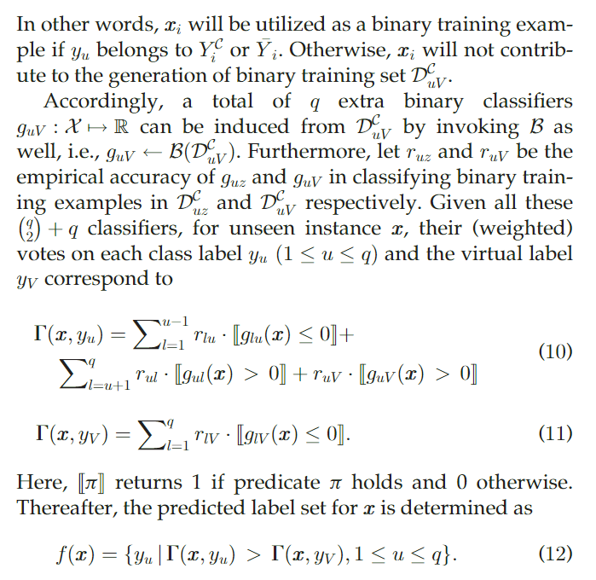
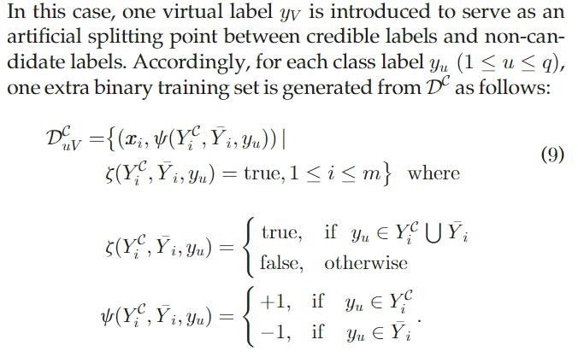
Partial Multi-Label Learning via Credible Label Elicitation
2.1. Virtual Label Splitting

Slide 9
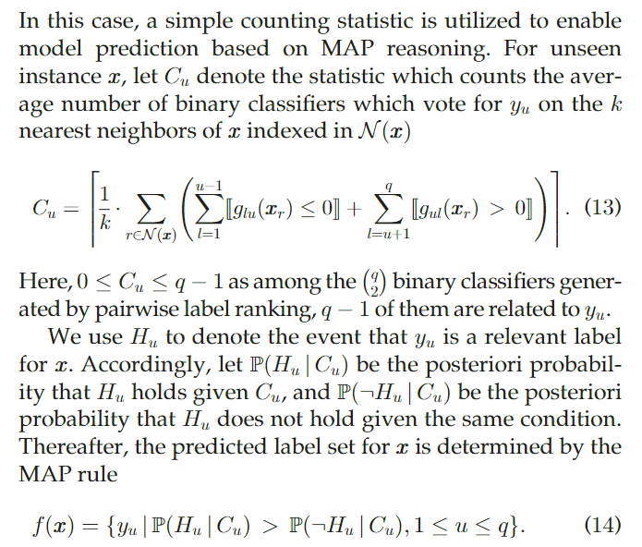
Partial Multi-Label Learning via Credible Label Elicitation
2.2. MAP Reasoning

Slide 10
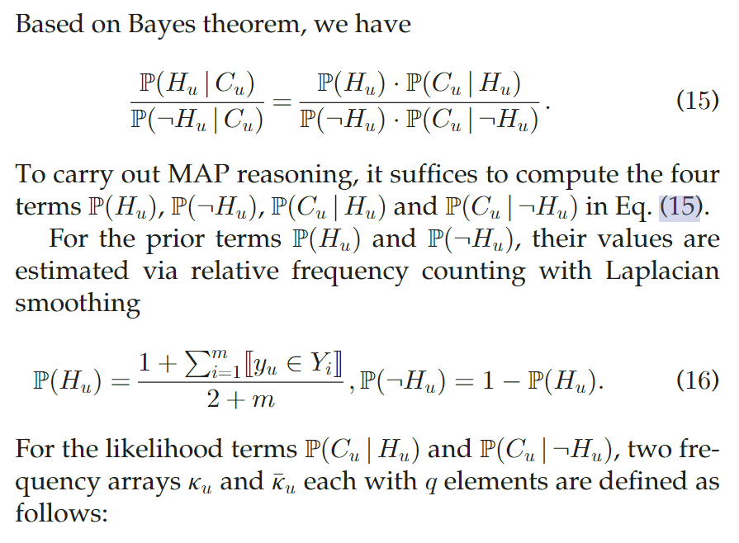
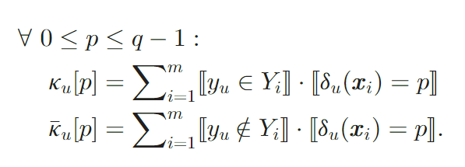
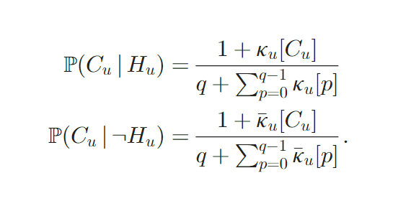
Partial Multi-Label Learning via Credible Label Elicitation
2.2. MAP Reasoning

Slide 11
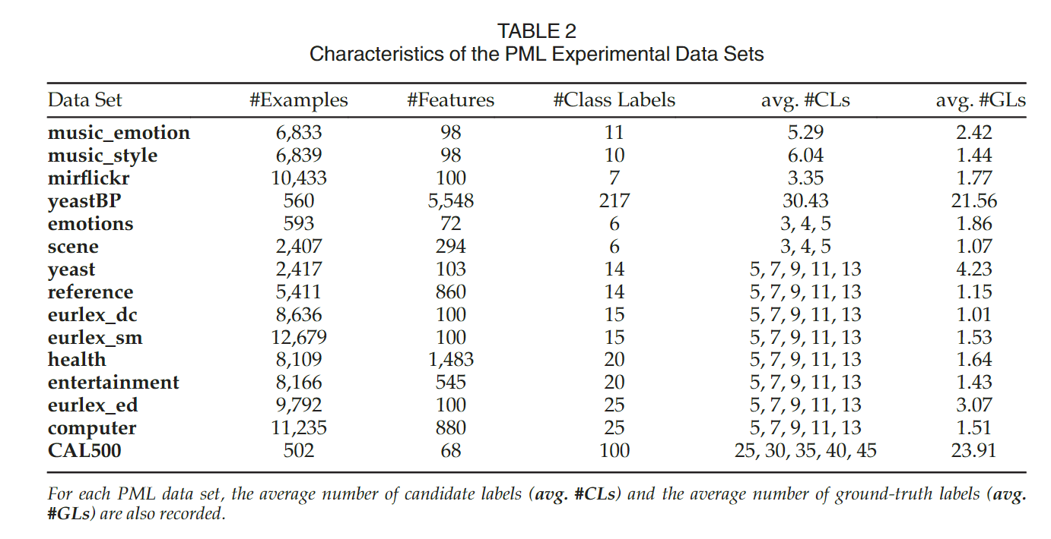
Partial Multi-Label Learning via Credible Label Elicitation
3. Experiments
使用虚拟标签分割和MAP推理实例化的两个PARTICLE变体分别被称为PARTICLE-VLS和PARTICLE-MAP。

Slide 12
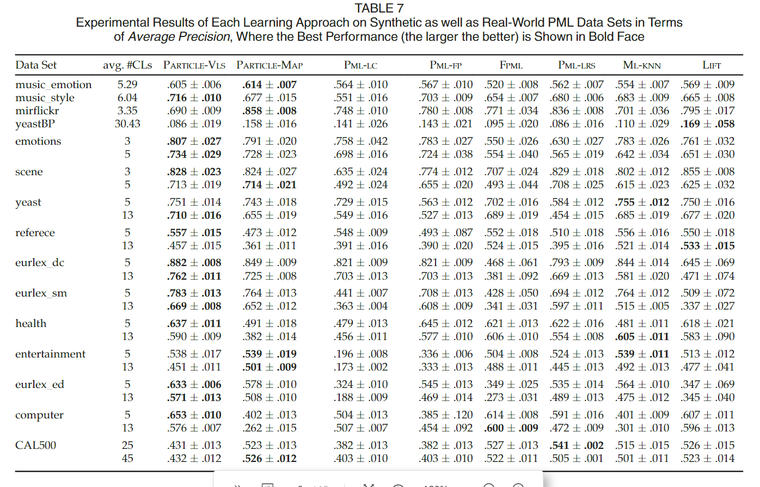
Partial Multi-Label Learning via Credible Label Elicitation
3. Experiments

Slide 13
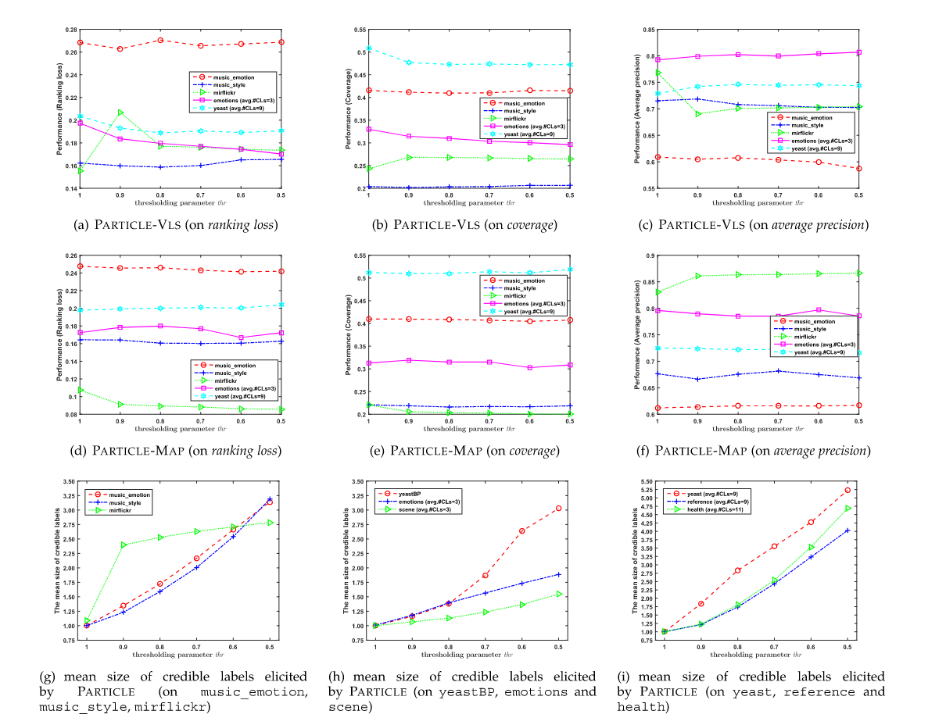
Partial Multi-Label Learning via Credible Label Elicitation
3. Experiments
当thr减小到0.9时，P ARTICLE的预测性能相对稳定，这也是本文使用的数值。
此外，如图(g)、(h)和(i)所示，随着thr的降低，引出的可信标签的平均大小以线性或次线性的速度增加。

Slide 14
谢谢大家

